Slide 1
Population Trend in 60 Years
Chuan Sun
7/31/2016
Shiny Project @ NYC Data Science Academy

Slide 2
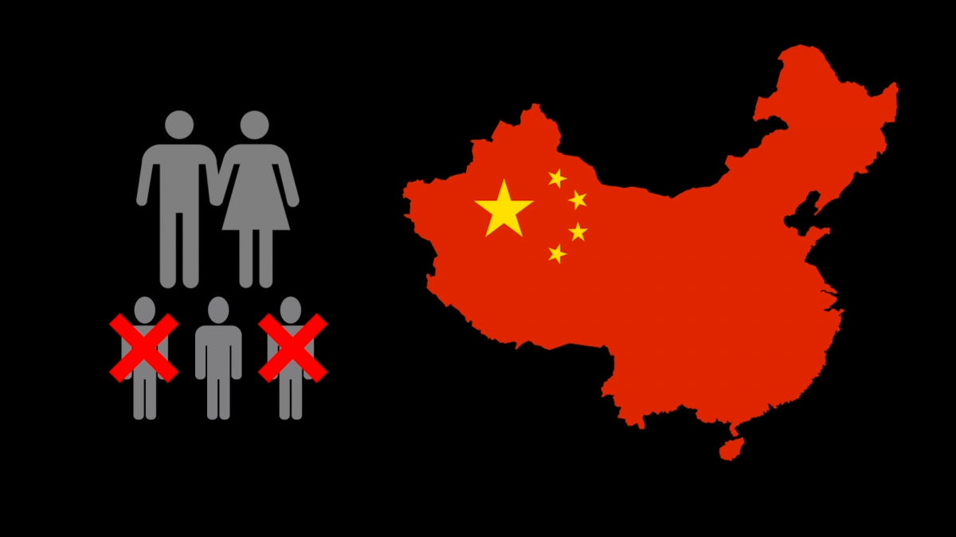
“Type a quote here.”
–Johnny Appleseed

Slide 3
7,440,396,251

Slide 4
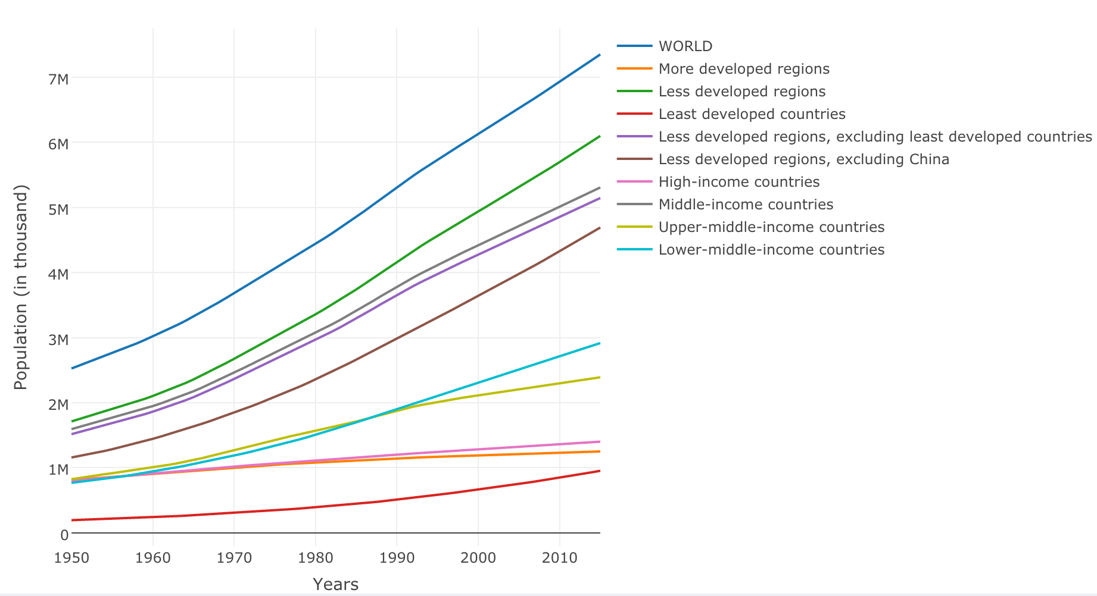
World

Slide 5

“Type a quote here.”
–Johnny Appleseed

Slide 6
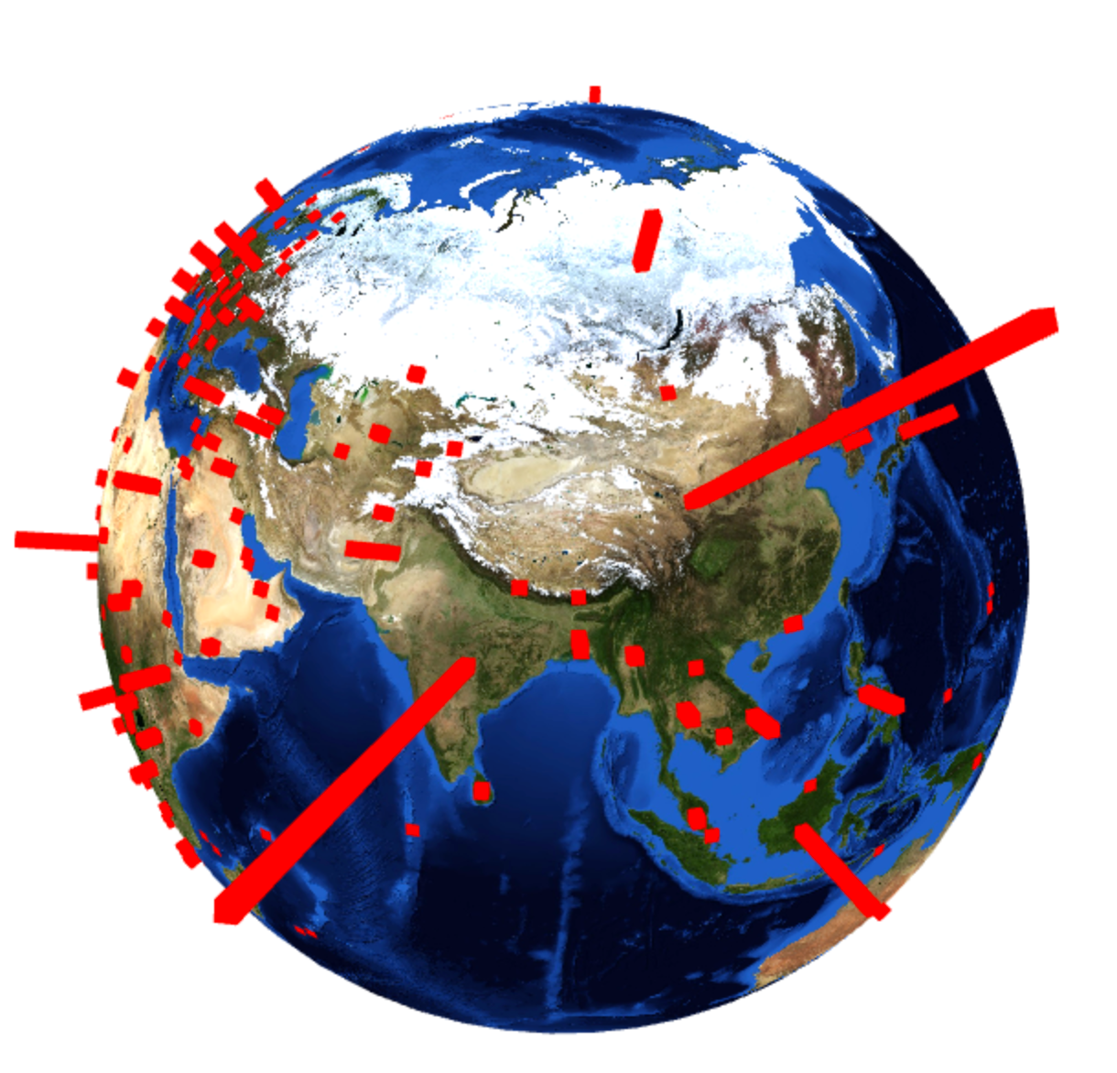
“Type a quote here.”
–Johnny Appleseed

Slide 7
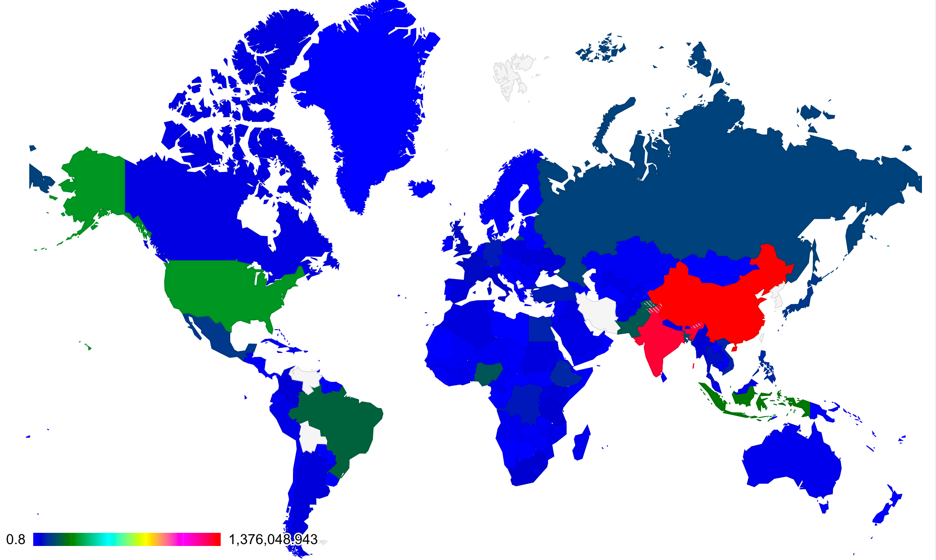
World population in 2015

Slide 8
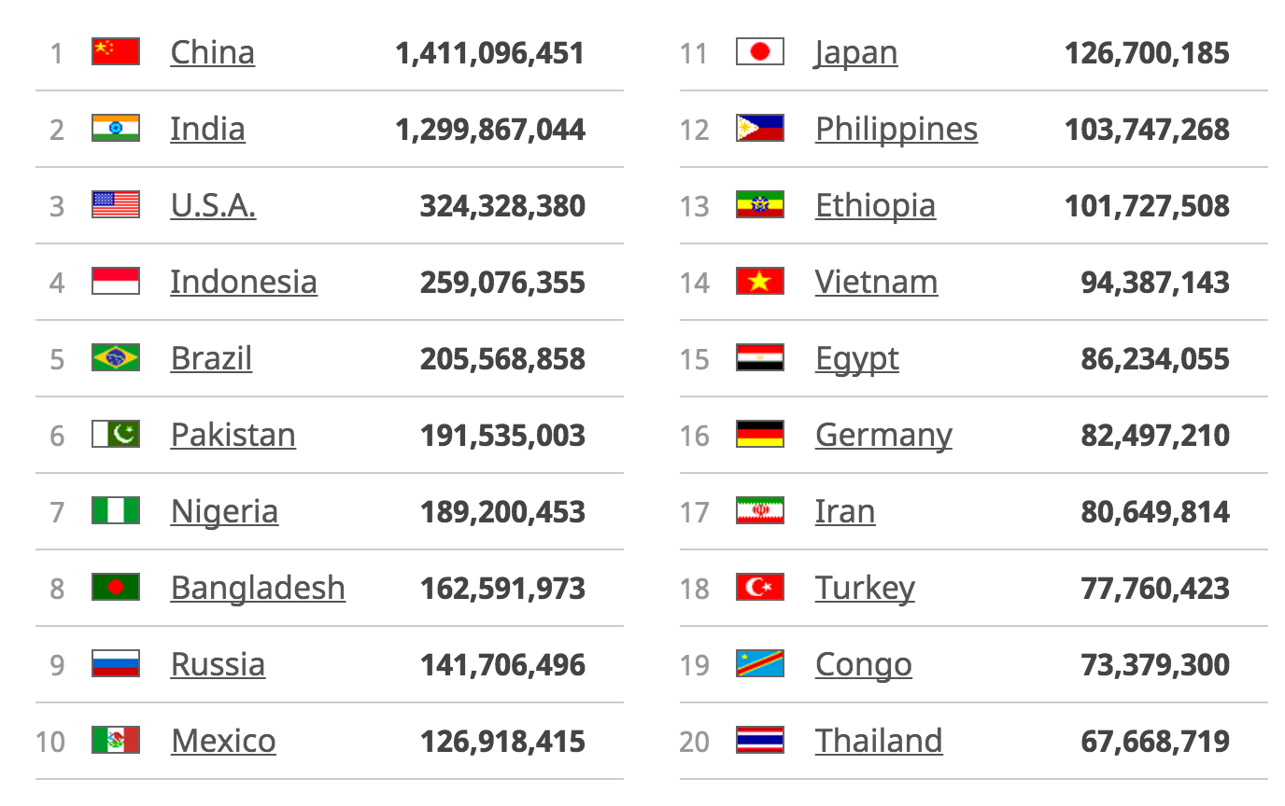

Slide 9
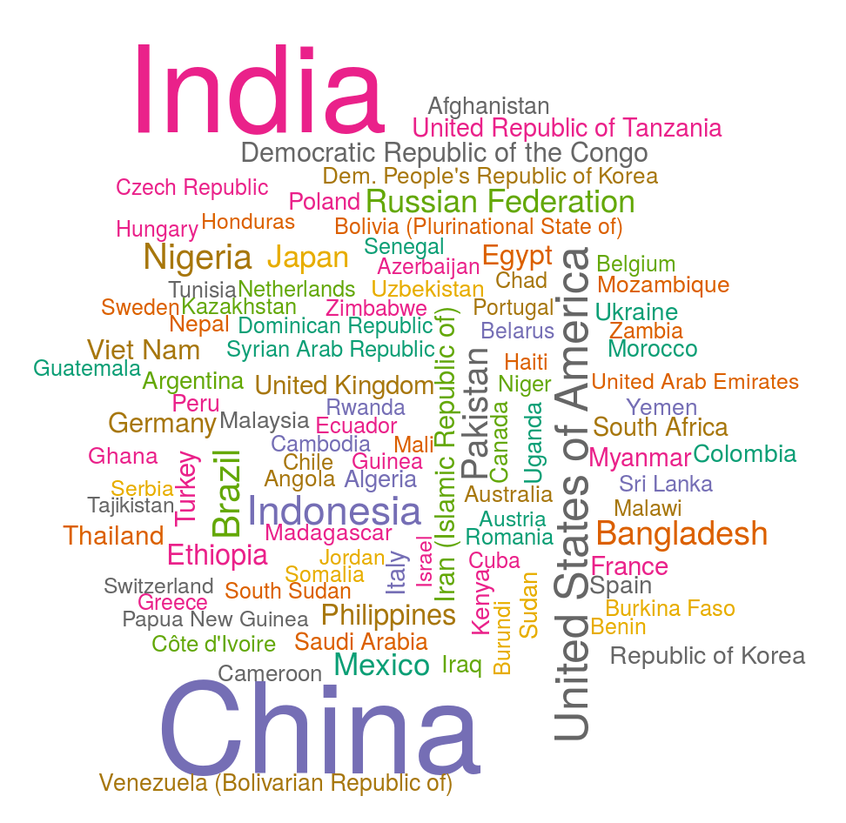
2015

Slide 10
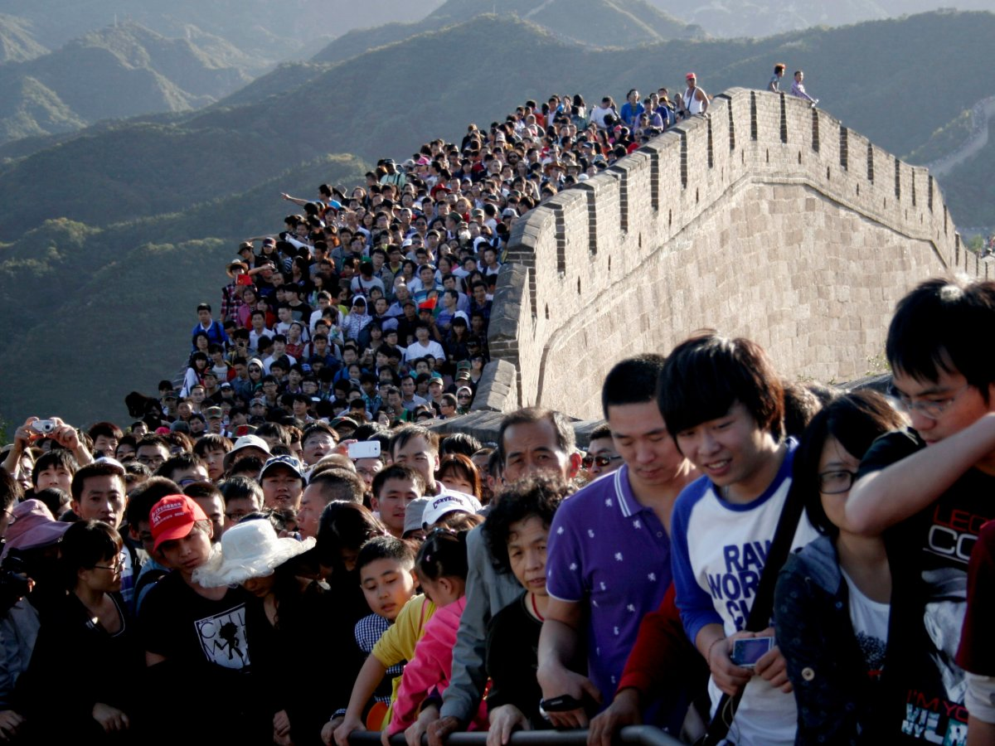

Slide 11
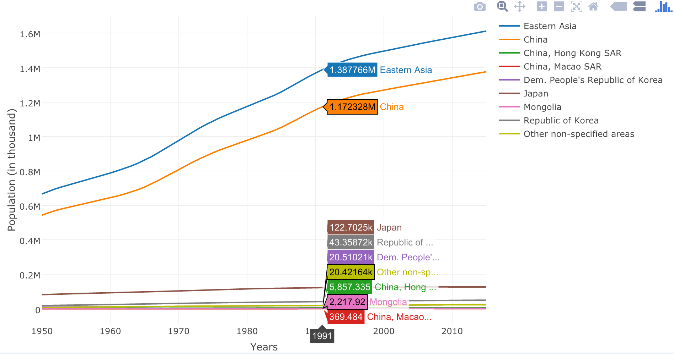
Eastern Asia

Slide 12
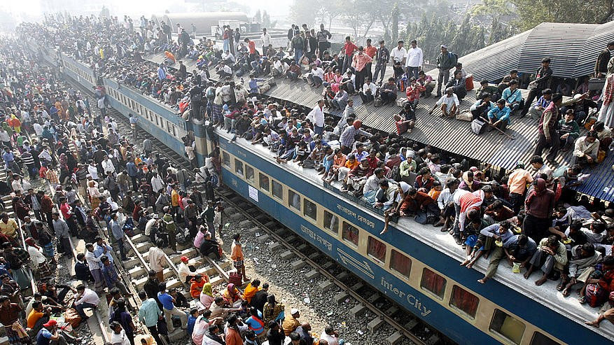
“Type a quote here.”
–Johnny Appleseed

Slide 13
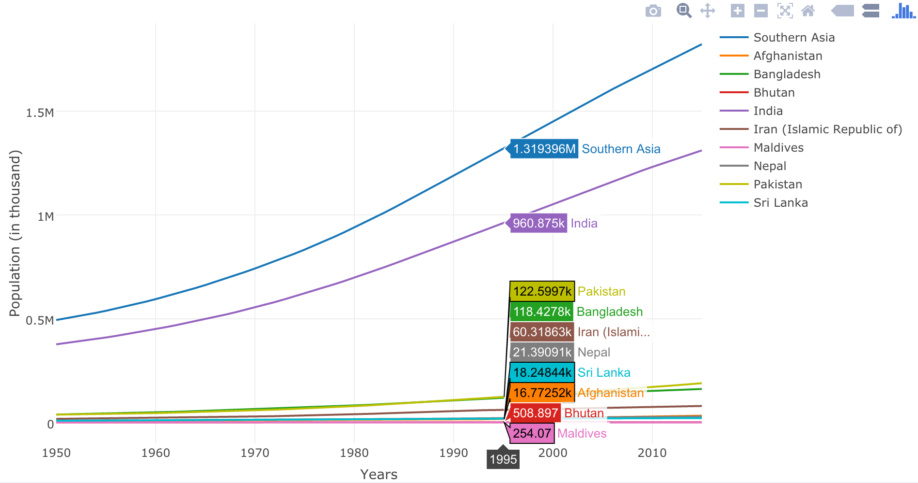
Southern Asia

Slide 14
Northern America

Slide 15
20/80

Slide 16
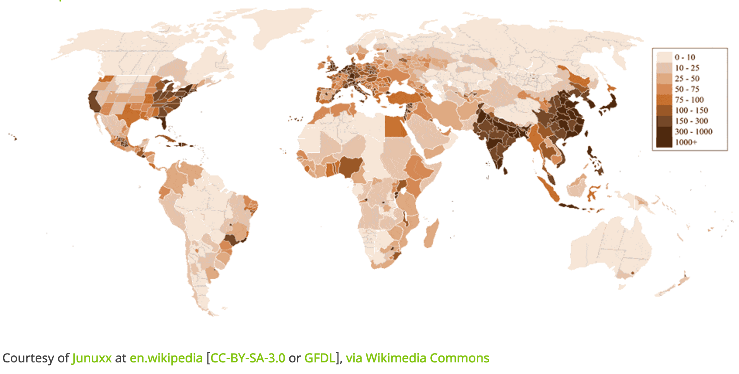

Slide 17
Thank you!

